Slide 1
So, you wanna give a tech talk? David Makogon, Microsoft
#novacodecamp
@dmakogon
www.dmak.io

Slide 2


Who am I??? (hint: → David Makogon)
Azure architect
Camera carrier
Pun penner
NoSQL non-novice
Community congrat collector
- (World's first former) Azure MVP
- (Former) MongoDB Master
- Neo4j Ambassador
If there's one thing that's not clear to me, it's opaqueness.

Slide 3

Imagine that Great Amazing Thing you just worked on, and OH WHAT A STORY YOU COULD TELL! It has bells, whistles, drama, intrigue. There's some crafty code and a rarely-used workaround that could Change The World As We Know It! It talks about a new framework! And you have jokes! And pictures! And and and...
And... you have a huge audience filling seats. Different backgrounds. Different primary spoken language. Different eyesight & hearing. Different coding skills. Different attention spans. HOW WILL YOU SURVIVE!?!?
Having given, and watched, a huge bunch* of talks worldwide, I've learned many things that help (and hurt) presentations. In this talk, I'll attempt to use the "things that help" to show you things that help AND things that hurt** in hopes that all of our future talks can help more and hurt less.
*Huge bunch : a ridiculously-high number that gets larger every time I tell the story ** These things don't really hurt. But they may make you cringe. Or sigh. Or gasp.

Slide 4
Real simple agenda
Speaking tips n tricks (really, that's it)
Primarily for tech talks
Sorta applies to all talks

Slide 5
Pre-talk prep

Slide 6
Checklist - hardware
Laptop(s) + Power adapters
Video adapters
Network adapter
Hotspot
Clicker / pointer / mouse
Batteries (charged, plus extras)

Slide 7
Checklist - software
Apps installed
Code downloaded / cloned
Directory-jump quick-links
Start / test utilities (e.g. ZoomIt)
Configure WiFi
Azure? Test non-web ports

Slide 8
Checklist – non-essentials
Shut down email / chat
Shut unneeded browser tabs
Turn off:
screen savers
notifications
sleep

Slide 9
Checklist – before presenting
Screen test / resolution test
Microphone test
Network test
Code / text display test
Bathroom break

Slide 10
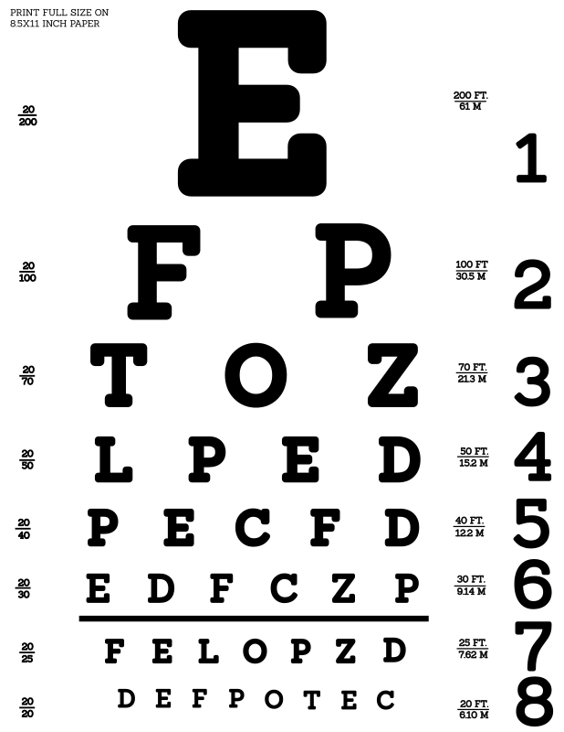
Eye charts

Slide 11
Obligatory "bullet" eye-chart slide
Think about the content you're showing. Do you really need bullets at all? Does the little dot on the left help, or just look like annoying dots down the page?
Should bullets be shown all at once, or slow-rolled so that your audience can follow along?
Do you really need to write entire paragraphs to get your point across, or maybe you could just reduce to a few key words?

Slide 12
Bullets (or not)
Bullets: Yay nor nay?
Make your point

Slide 13
Fonts (and code)
view.on('init', function (next) {
var q = keystone.list('Post').paginate({
page: req.query.page || 1,
perPage: 10,
maxPages: 10,
filters: {
state: 'published',
},
})
.sort('-publishedDate')
.populate('author categories');
if (locals.data.category) {
q.where('categories').in([locals.data.category]);
}
q.exec(function (err, results) {
locals.data.posts = results;
next(err);
});
});
var q = keystone.list('Post').paginate({
page: req.query.page || 1,
perPage: 10,
maxPages: 10,
filters: {
state: 'published',
},
})
.sort('-publishedDate')
.populate('author categories');
Keystone.js – blog post listing
view.on('init', function (next) {
var q = keystone.list('Post').paginate({
page: req.query.page || 1,
perPage: 10,
maxPages: 10,
filters: {
state: 'published',
},
})
.sort('-publishedDate')
.populate('author categories');
if (locals.data.category) {
q.where('categories').in([locals.data.category]);
}
q.exec(function (err, results) {
locals.data.posts = results;
next(err);
});
});

Slide 14
Code editor…

Slide 15
Human interaction

Slide 16
Know your audience
Skill level and background
Primary language (in general)
Assignment: look around you

Slide 17
Jokes
Political
Off-color
If someone complains at an animal adoption center, do they come home with a pet peeve?
Adult
Country-specific

Slide 18
Your voice
The volume
The direction
The mic
Notes:
Mic: learn to turn off (drinking, coughing)
Don’t face the screen when talking
Project your voice if no mic.
Always use mic! Clip-on is best
Remember the back of the room

Slide 19
Your location
Where are you hiding???
Are you moving?

Slide 20
Highlighting
Pointing devices
Zooming
Hand gestures
“As you can see…”

Slide 21
Dealing with questions
Repeat
Repeat
Repeat
Repeat
Repeat
Repeat
Repeat
Repeat
It’s ok to cut short
(politely)

Slide 22
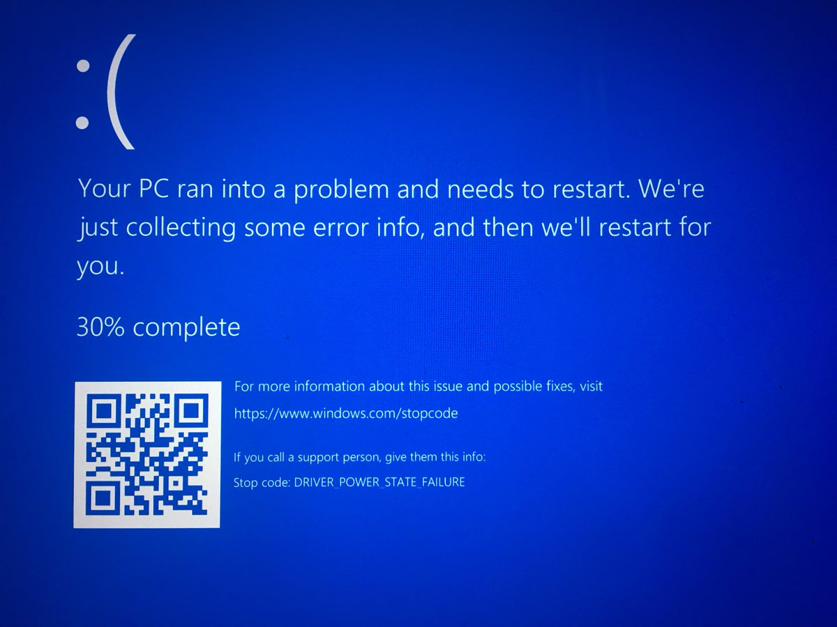

Slide 23
Dealing with #FAIL
Computer crash
Network failure
Mouse failure
Clicker failure
Demo failure

Slide 24
Terms and acronyms
Don’t assume people know them!

Slide 25
Dead air
Narrate
Talk through things

Slide 26
Questions?
Keep in touch!
Twitter: @dmakogon
Blog: dmak.io
Azure stuff at Azure.com
Neo4j stuff at neo4j.com
Talk stuff at github.com/dmakogon/hrnug2016

